Slide 1

CHINOOK MUSIC STORE
An In-Depth Sales and Customer Analysis 29/08/2024

Slide 2

Introduction
Objective: The Chinook Music Store analysis aims to uncover critical insights into sales trends, customer behavior, and product associations. The primary goal is to identify opportunities to enhance sales, improve customer engagement, and develop strategic cross-selling opportunities.
Scope: This analysis is focused on the following areas:
Sales Trends: Exploration of sales data over a multi-year period, identifying top-selling artists, albums, and genres.
Genre Popularity: Investigation of customer preferences in music genres, highlighting the most popular genres by year and uncovering shifts in consumer tastes.
Customer Segmentation: A detailed analysis of customer segments based on purchasing behavior, identifying the most valuable customers and potential growth opportunities.
Market Basket Analysis: Examination of frequently bought-together items, both albums and tracks, to reveal cross-selling opportunities and strengthen product bundling strategies

Slide 3
Key Questions Addressed
Which artists, albums, and genres drive the most sales for Chinook Music Store?
How has customer behavior evolved over the analyzed period, and what are the key customer segments?
What product associations exist between albums and tracks, and how can these be leveraged for cross-selling?

Slide 4

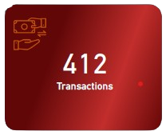
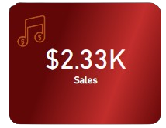
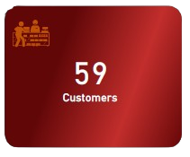
Key Metrics
The store handled 412 unique transactions, reflecting the level of activity in the business over the analyzed period.
With total sales amounting to $2.33K, this figure demonstrates the revenue generated through music sales.
The 59 unique customers who engaged with the store point to a dedicated user base, suggesting opportunities for further growth

Slide 5
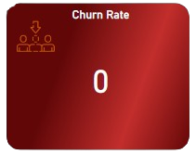
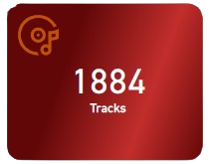
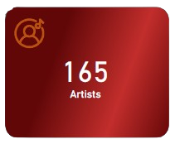
Key Metrics
The store offers an impressive collection of 1,884 tracks, providing customers with a wide selection of music across various genres.
The churn rate stands at 0%, indicating excellent customer retention. This is a key sign of strong customer loyalty and satisfaction
Featuring 165 artists in the catalog, the diversity of artists highlights the store’s ability to cater to a wide audience with varied musical preferences

Slide 6
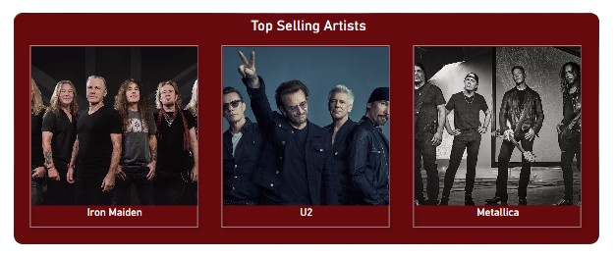
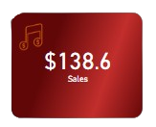
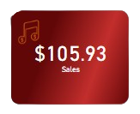
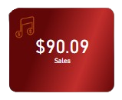
Sales Analysis
The top-selling artists—Iron Maiden, U2, and Metallica—dominate the sales during this period. These rock and metal artists have consistently high sales performance, reflecting a strong customer base that favors rock and metal genres.
Iron Maiden generated the highest sales revenue of $138.6, reflecting its strong popularity and fan base
U2 follows with $105.93 in sales, showing that it also enjoys considerable support from customers.
Metallica brought in $90.09 in sales, securing its spot as one of the most sought-after artists on the platform

Slide 7
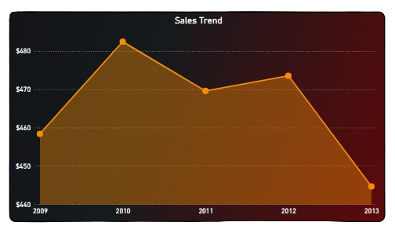
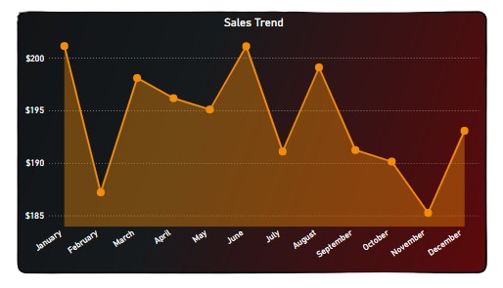
Sales Analysis
Over the five-year period, sales experienced significant fluctuations, with the highest peaks occurring in 2010 and 2012. Despite these surges, overall sales have shown a declining trend, dropping consistently after 2010. This could suggest a shift in market conditions or changes in customer preferences
The monthly sales trend shows noticeable peaks in January, March, June and August, indicating periods of high customer activity and possibly aligned with key promotions or product releases. However, there is a steep decline in sales towards November, which could point to a seasonal drop in demand or lower promotional efforts at the year's end.

Slide 8
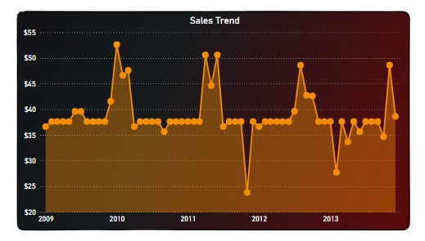
Sales Analysis
This visual shows monthly sales trends from 2009 to 2013, marked by several peaks and valleys. Notable spikes in each year may reflect successful promotions or popular releases. Despite fluctuations, the sales generally hover between $30 to $40 per month, indicating a consistent but modest revenue stream

Slide 9
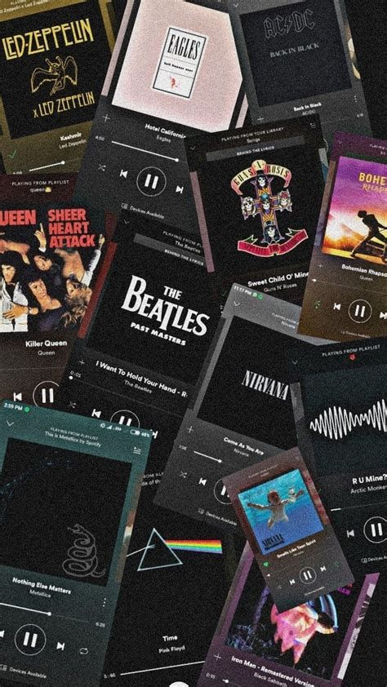
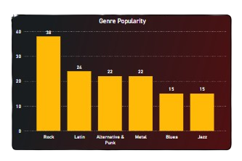
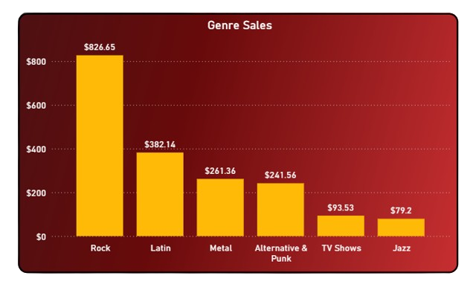
Genre Popularity
The Genre Analysis reveals key trends in music preferences among Chinook Music Store customers. The top genres, such as Rock, Latin, and Alternative & Punk, dominate sales, indicating a strong customer preference.
In terms of sales, Rock remains the highest-grossing genre, earning $826.65, followed by Latin music with $382.14 in sales. Although other genres like Metal, Alternative & Punk, and TV Shows contributed less to total sales, their presence is still significant

Slide 10
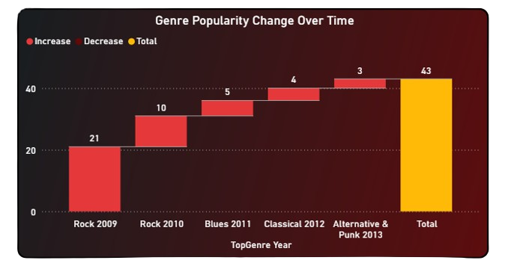
Genre Popularity
The Genre Popularity Change Over Time chart shows how Rock music dominated the store between 2009 and 2010 with 31 occurrence's, popularity changed in subsequent years. By 2013, Alternative & Punk became the most popular genre each having notable popularity levels. This data suggests a strong preference for rock, but the growing popularity of other genres hints at a shift in consumer tastes over time.

Slide 11
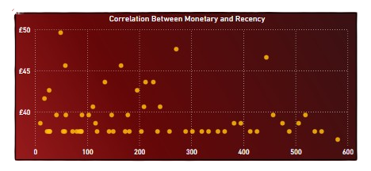
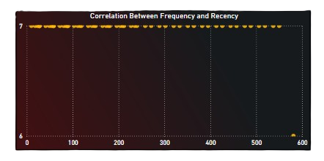
Customer Segmentation
visual shows a strong correlation between frequency and recency, with most customers having a high frequency of purchases occurring recently. This suggests a highly engaged customer base that returns to make purchases frequently over a short period.
we observe that customers who spent more recently tend to have higher monetary values. However, there is greater variation in the monetary value, indicating that some customers spend significantly more than others, regardless of when their last purchase was made. This suggests the potential for targeted strategies focusing on both high-frequency and high-value customers

Slide 12
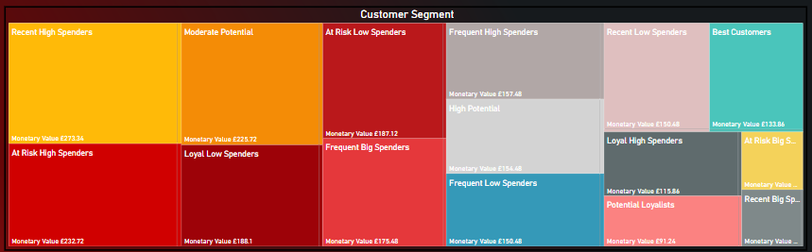
Customer Segmentation
Recent High Spenders (Large Yellow Block) and Best Customers (Large Green Block) are the core revenue drivers. Any strategy must prioritize retaining these customers.
The existence of At Risk High Spenders (Large Red Block) indicates a significant group that has spent heavily but is showing signs of reduced engagement (lower recency/frequency). Losing this segment would result in the highest and most immediate financial loss, making them a top priority for win-back campaigns.

Slide 13

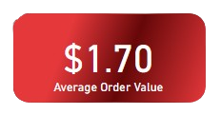
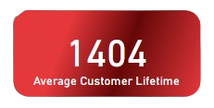
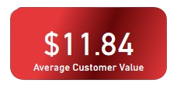
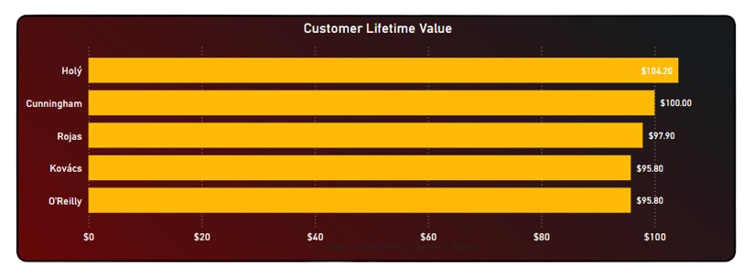
Customer Lifetime Value
On average, each transaction is worth $1.70, emphasizing that customers make relatively small but frequent purchases
Customers typically stay engaged with the business for approximately 1,404 days (around 4 years). This long customer lifecycle suggests that customers are loyal and tend to return for repeat purchases
on average, each customer generates $11.84 in revenue
The chart reveals that Hajj is the most valuable customer, contributing a significant $70.96, followed by Cunningham and Reggie with $70.00 and $59.70, respectively.

Slide 14
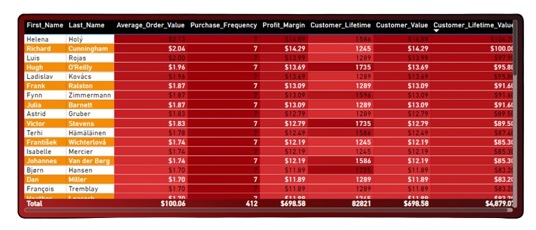
Customer Lifetime Value
Top CLV Drivers: The top few customers—Helena Holy ($104.30), Richard Cunningham ($100.00), and Luis Rojas ($97.98)—have the highest individual Customer Lifetime Value. These customers are disproportionately important to the business's long-term health.
Consistent Frequency: Nearly all of the top-ranked customers have a consistent Purchase_Frequency of 7. This is a strong indicator that repeat business is the primary driver of high CLV

Slide 15

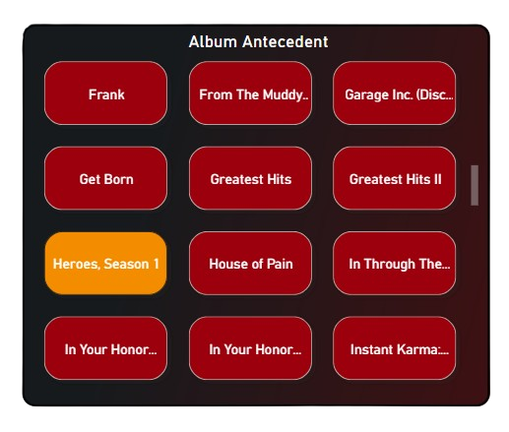
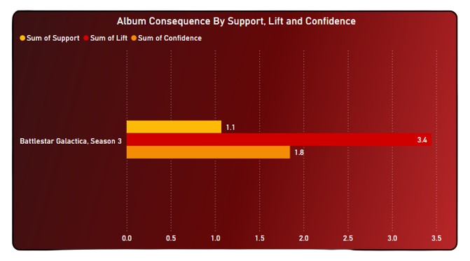
Market Basket
The Market Basket Analysis shows a strong pairing between Heroes Season 1 and Battlestar Galactica Season 3, with a purchase frequency of 24. While this is the most frequent combination, it is limited to this specific pairing without broader purchase influence.
The chart shows the strength of the association with a confidence level of 1.8 and a lift of 3.4, suggesting that customers who buy Heroes Season 1 are more likely to purchase Battlestar Galactica Season 3 as well.

Slide 16
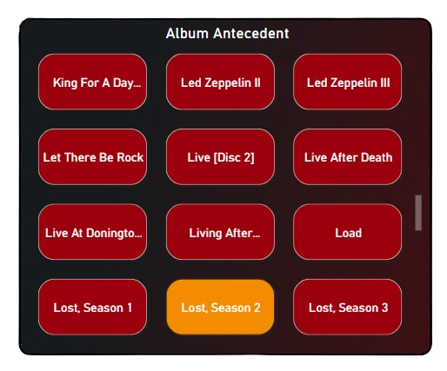
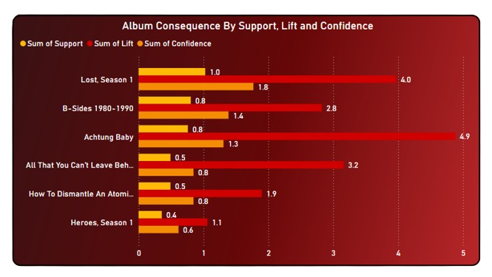
Market Basket
The Market Basket Analysis reveals that Lost, Season 2 is a key album that leads to the purchase of several other albums. Most notably, it frequently results in the purchase of Lost, Season 1 with a high confidence score of 4.0. Albums like Achtung Baby and B-Sides 1980-1990 also follow, showing strong connections with Lost, Season 2, supported by high confidence scores (4.9 and 2.8 respectively). The modest support and lift values suggest that while the frequency of these pairings isn't extremely high, they consistently occur when Lost, Season 2 is the antecedent.

Slide 17
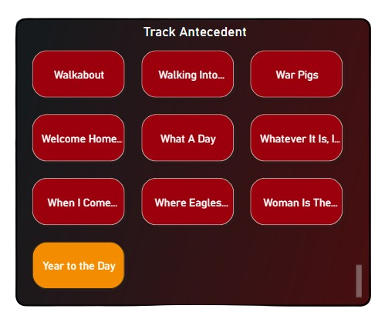
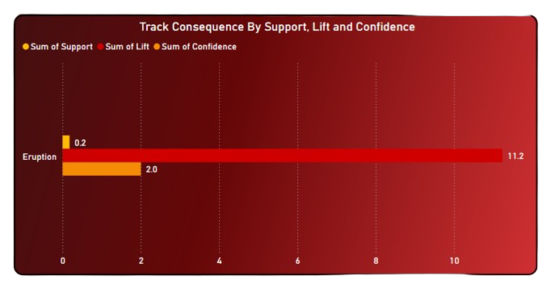
Market Basket
The Market Basket Analysis reveals a notable pairing between Year to the Day and Eruption, with a confidence of 2. it shows a strong association, as indicated by the high lift value of 11.2.

Slide 18
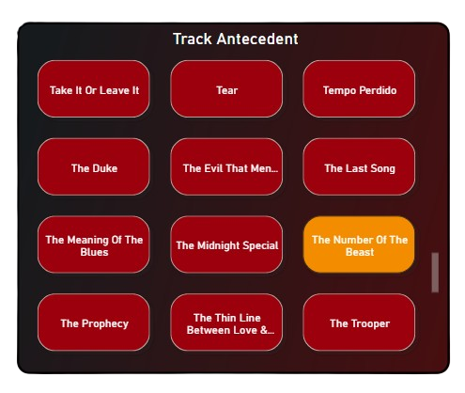
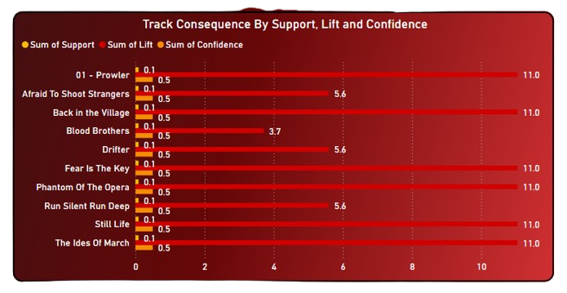
Market Basket
The Market Basket Analysis shows that The Number of the Beast is a key driver, leading to the purchase of 10 other tracks. With high confidence scores (mostly 11.0), tracks like Prowler, Afraid to Shoot Strangers, and Phantom of the Opera frequently follow. While the lift and support values are modest, the consistent purchases suggest a loyal customer base opting for these associated tracks after The Number of the Beast

Slide 19

Key Insights
3. Customer Behavior & Segmentation
The 0% churn rate underscores strong customer loyalty and repeat patronage, suggesting high satisfaction with the store’s offerings.
RFM segmentation revealed that recent and frequent buyers tend to spend more, emphasizing the value of consistent engagement and retention programs.
On average, customers stayed active for 1,404 days (≈ 4 years) and generated $11.84 each, highlighting long-term engagement potential.
4. Customer Lifetime Value (CLV)
The most valuable customer, Hajj, contributed $70.96, followed by Cunningham ($70.00) and Reggie ($59.70).
Average transaction value stood at $1.70, showing that customers make small but frequent purchases — ideal for promoting bundles and loyalty rewards.
5. Market Basket Analysis
Strong product associations were identified between:
Heroes Season 1 → Battlestar Galactica Season 3 (Lift: 3.4)
Lost Season 2 → Lost Season 1 / Achtung Baby / B-Sides 1980–1990
The Number of the Beast → Prowler / Afraid to Shoot Strangers / Phantom of the Opera

Slide 20
Key Insights
1. Sales Performance & Trends
The Chinook Music Store processed 412 transactions, generating $2,330 in total sales from 59 unique customers, indicating a steady but limited customer base.
Sales showed peak activity in 2010 and 2012, followed by a gradual decline, suggesting changing market dynamics or a shift in customer purchasing behavior.
Monthly patterns revealed sales spikes in January, March, June, and August, likely tied to seasonal promotions or major music releases, with a dip toward year-end.
2. Genre & Artist Popularity
Rock dominated the genre landscape, generating $826.65, followed by Latin ($382.14) and Alternative & Punk, showing a strong consumer bias toward energetic genres.
Iron Maiden ($138.6), U2 ($105.93), and Metallica ($90.09) were top-selling artists, accounting for a significant portion of total revenue.
Over time, Alternative & Punk music gained traction, signaling an evolving audience taste and a diversification opportunity beyond traditional Rock.

Slide 21
Recommendation
1. Diversify Product Promotion
Expand focus to emerging genres like Alternative & Punk to capture shifting audience preferences.
Offer targeted promotions or playlist bundles around high-performing artists and albums.
2. Implement Loyalty and Cross-Sell Strategies
Leverage Market Basket results to create personalized bundles (e.g., “Fans who bought The Number of the Beast also enjoyed Prowler”).
Introduce loyalty rewards for frequent and long-term customers to maintain the current 0% churn rate.
3. Data-Driven Marketing
Use insights from sales trends to align promotional campaigns with high-activity months (Jan, Mar, Jun, Aug).
Develop dynamic dashboards to monitor revenue, engagement, and genre performance in real-time.
4. Customer Value Optimization
Implement tiered engagement programs to increase the average customer value beyond $11.84.
Provide incentives for high-frequency customers to upgrade to premium offers or multi-genre purchases.
5. Operational Insight
Investigate the post-2012 sales decline — possibly caused by digital streaming trends — and adjust strategy to integrate streaming analytics or subscription-based models.

Slide 22
Conclusion
The analysis of the Chinook Music Store dataset highlights a loyal but narrow customer base, dominated by Rock and Latin genres, and an emerging opportunity in Alternative & Punk music.
While overall sales remain modest, the data reveals a highly engaged audience, consistent purchasing patterns, and clear pathways to boost revenue through cross-selling, loyalty programs, and genre diversification.
By combining these insights with predictive analytics and strategic marketing, Chinook can evolve from a traditional music store into a data-driven digital retailer — optimizing customer experience and maximizing profitability

